Slide 1


Green Pace
Security Policy Presentation
Developer: Jorge Torres

Slide 2

OVERVIEW: DEFENSE IN DEPTH
Our new security policy emphasizes robust encryption practices and the Triple-A framework (Authentication, Authorization, and Accounting) to enhance our defense-in-depth strategy.

Slide 3
THREATS MATRIX
[Populate the Threats Matrix table and provide explanations to summarize of all of your security risks.]
Likely Threats, could potentially happen. | Priority Standard with high Importance
Low priority Standard with low importance | Unlikely Threats with low potential to happen

Slide 4
10 PRINCIPLES
1. Validate Input Data
2. Heed Compiler Warnings
3. Architect and Design for Security Policies.
4. Keep it Simple
5. Default Deny
6. Adhere to the Principle of Least Privilege
7. Sanitize Data Sent to Other Systems
8. Practice Defense in Depth
9. Use Effective Quality Assurance Techniques
10. Adopt a Secure Coding Standard

Slide 5
CODING STANDARDS
FIO30-C: Medium severity, moderate likelihood, low remediation cost.
MEM34-C: High severity, moderate likelihood, medium remediation cost.
MSC12-C: High severity, moderate likelihood, medium remediation cost.
ERR55-CPP: High severity, moderate likelihood, medium remediation cost.
DCL03-CPP: High severity, moderate likelihood, medium remediation cost.
MEM31-C: High severity, moderate likelihood, medium remediation cost.
CON50-CPP: High severity, moderate likelihood, medium remediation cost.
STD-001-CPP: High severity, unlikely likelihood, medium remediation cost.
STD-ERR34-C: High severity, unlikely likelihood, medium remediation cost.
STD-STR51-CPP: High severity, unlikely likelihood, medium remediation cost.
To prioritize these coding standards effectively, consider their severity, how likely they are to be violated, and the cost to fix issues. Focus on standards that have high severity and moderate likelihood, as these pose significant risks. Start with those that are easier and less costly to fix while addressing the most critical risks first. This approach ensures that you improve code quality and minimize vulnerabilities efficiently.

Slide 6
ENCRYPTION POLICIES
Encryption is a crucial security measure applied across different states of data:
Encryption at rest ensures data stored in databases, files, or backups is encrypted when not actively used, thwarting unauthorized access due to theft or breaches. This policy secures sensitive data to comply with regulations and prevent data breaches.
Encryption in flight safeguards data during transmission over networks, using protocols like HTTPS and VPNs to prevent interception. This policy maintains data integrity and confidentiality across systems and networks, thwarting eavesdropping and attacks.
Encryption in use protects data actively being processed or accessed, securing it from unauthorized exposure or access. Applied through mechanisms like memory encryption and application-level encryption, this policy prevents data leakage and unauthorized access during manipulation.

Slide 7
TRIPLE-A POLICIES
The Triple-A Framework encompasses three essential components for secure access management:
Authentication verifies the identity of users or systems attempting to access resources, employing methods like passwords, biometrics, or multi-factor authentication (MFA). This policy applies universally to secure systems and applications, preventing unauthorized access and identity theft, thereby ensuring compliance with security standards and protecting sensitive information.
Authorization determines the actions and privileges granted to authenticated users based on their roles, managed through access control lists (ACLs), role-based access control (RBAC), and policy-based controls. It enforces the principle of least privilege, limiting access to resources necessary for users' roles, preventing unauthorized activities, and safeguarding sensitive data from unauthorized modification or deletion.
Accounting involves monitoring and logging user activities, system changes, and access to sensitive data for accountability and forensic purposes. Implemented through logging mechanisms, audit trails, and SIEM systems, this policy is crucial for detecting security incidents, supporting forensic investigations, and ensuring compliance with regulatory requirements. It enhances transparency in system operations, enabling organizations to effectively track and analyze security events.

Slide 8
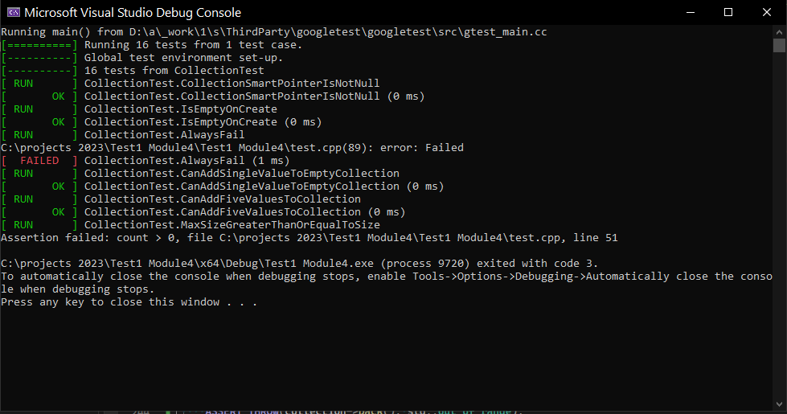
Unit Testing

Slide 9

AUTOMATION SUMMARY

Slide 10
TOOLS
Green Pace integrates automation deeply into their DevSecOps approach, ensuring that security and compliance are foundational at every phase of software development. They deploy tools early in the lifecycle to assess threats, analyze code, and enforce coding standards, thereby identifying vulnerabilities promptly and aligning with regulatory requirements effectively. Automated monitoring and incident response mechanisms in production enable swift detection and mitigation of security threats, maintaining the stability and security of their systems. This comprehensive automation strategy not only strengthens their security posture but also enhances operational efficiency, supporting continuous improvement and resilience across their DevOps workflows.
By embedding automation throughout their DevSecOps process, Green Pace not only prioritizes security but also enhances the reliability and efficiency of their software development lifecycle. This proactive approach ensures that security considerations are addressed from design through production, leveraging automated tools for threat detection, compliance checks, and incident response. By automating monitoring and maintenance tasks, Green Pace maintains a secure environment, swiftly identifying and mitigating security risks while optimizing operational processes. This integrated automation strategy not only enhances their ability to meet regulatory requirements and industry standards but also fosters a culture of continuous improvement and innovation within their DevOps operations.

Slide 11
RISKS AND BENEFITS
Coding inherently involves risks because achieving 100% security is impossible. It's crucial to always assume the presence of threats and vulnerabilities in the system. Continuously educating yourself on current threats and prevention techniques is essential for effectively mitigating these risks and ensuring the policy's success.

Slide 12
RECOMMENDATIONS
Staying updated on security threats and trends is essential for maintaining the promised level of security. We prioritize simplicity while ensuring effectiveness in accomplishing our goals.

Slide 13
CONCLUSIONS
To prevent future problems, adopting recognized standards and best practices in cybersecurity is crucial. Some key standards to consider include:
ISO/IEC 27001: A widely recognized standard for information security management systems (ISMS), ensuring comprehensive management of security risks.
NIST Cybersecurity Framework: Developed by the National Institute of Standards and Technology (NIST), providing a framework for improving cybersecurity posture by categorizing, prioritizing, and managing cybersecurity risks.
PCI DSS (Payment Card Industry Data Security Standard): Ensures secure handling of credit card information to prevent data breaches and fraud.
GDPR (General Data Protection Regulation): For organizations handling personal data of EU citizens, ensuring compliance with stringent data protection and privacy rules.
OWASP (Open Web Application Security Project) Top 10: Provides guidelines for securing web applications against the most critical security risks.
CIS Controls (Center for Internet Security Controls): Offers a set of cybersecurity best practices that mitigate the most common attacks.

Slide 14
REFERENCES
ISO/IEC 27001:International Organization for Standardization. (n.d.). ISO/IEC 27001: Information security management. Retrieved from https://www.iso.org/isoiec-27001-information-security.html
NIST Cybersecurity Framework:National Institute of Standards and Technology. (n.d.). NIST Cybersecurity Framework. Retrieved from https://www.nist.gov/cyberframework
PCI DSS (Payment Card Industry Data Security Standard):PCI Security Standards Council. (n.d.). PCI Security Standards. Retrieved from https://www.pcisecuritystandards.org
GDPR (General Data Protection Regulation):European Union. (n.d.). General Data Protection Regulation (GDPR). Retrieved from https://gdpr.eu
OWASP (Open Web Application Security Project) Top 10:OWASP. (n.d.). OWASP Top Ten. Retrieved from https://owasp.org/www-project-top-ten
CIS Controls (Center for Internet Security Controls):Center for Internet Security. (n.d.). CIS Controls. Retrieved from https://www.cisecurity.org/controls/

